Slide 1
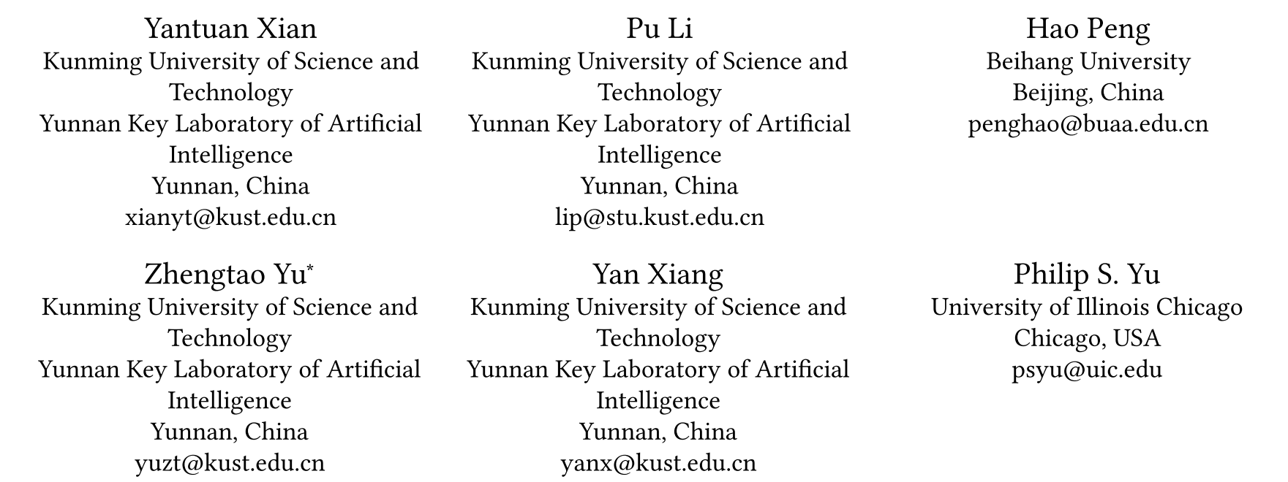
ATAI
Advanced Techniqueof Artificial Intelligence
ATAI
ChongqingUniversity _{AdvancedTechniqueof}
of Technology Artificial Intelligence
Chongqing University of
Technology
Chongqing University ^{ATAI}
_{of Technology} Advanced Techniqueof
Artificial Intelligence
Chongqing University of Technology
Chongqing University of Technology
Community Detection in Large-Scale Complex Networks via Structural Entropy Game
Code: https://github.com/SELGroup/CoDeSEG
2025.3.14 •ChongQing
—— WWW_2025
Reported by Shiyan Wu
1

Slide 2
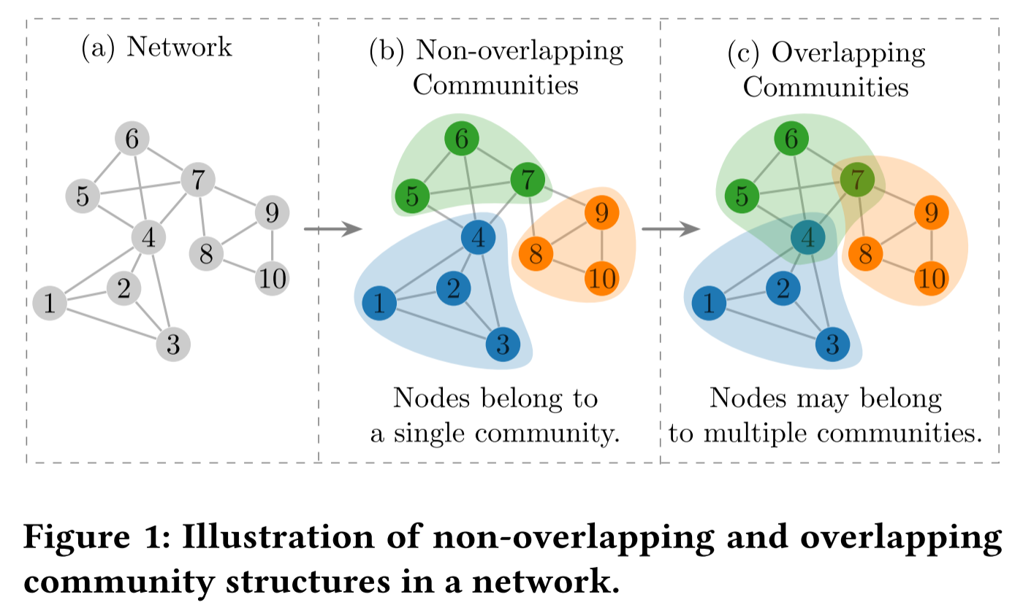
ATAI
AdvancedTechniqueof
Artificial Intelligence
ATAI
ChongqingUniversity _{AdvancedTechniqueof}
of Technology Artificial Intelligence
ChongqingUniversity of Technology
Motivation
1. Current community detection methods are inefficient in large-scale networks, struggling to process millions of nodes and billions of edges quickly, especially for overlapping communities;
2. Many methods are confined to unweighted and undirected graphs, with limited adaptability to weighted and directed graphs.

Slide 3
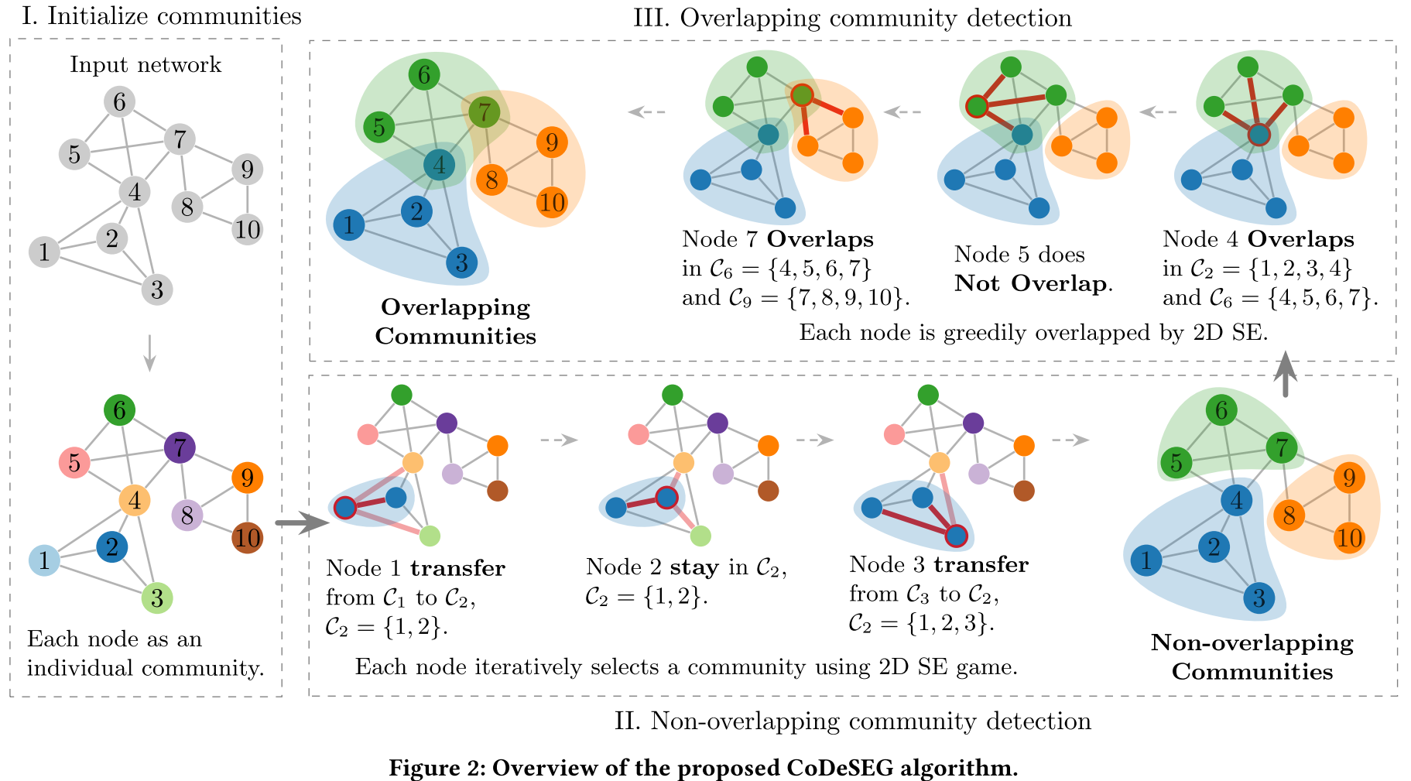
ChongqingUniversity of Technology
ATAI
AdvancedTechniqueof
Artificial Intelligence
ATAI
ChongqingUniversity _{AdvancedTechniqueof}
of Technology Artificial Intelligence
Overview

Slide 4
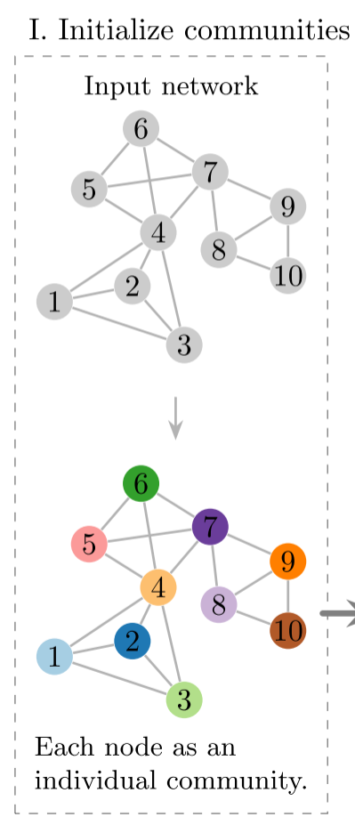
ChongqingUniversity of Technology
ATAI
AdvancedTechniqueof
Artificial Intelligence
ATAI
ChongqingUniversity _{AdvancedTechniqueof}
of Technology Artificial Intelligence
Method

Slide 5
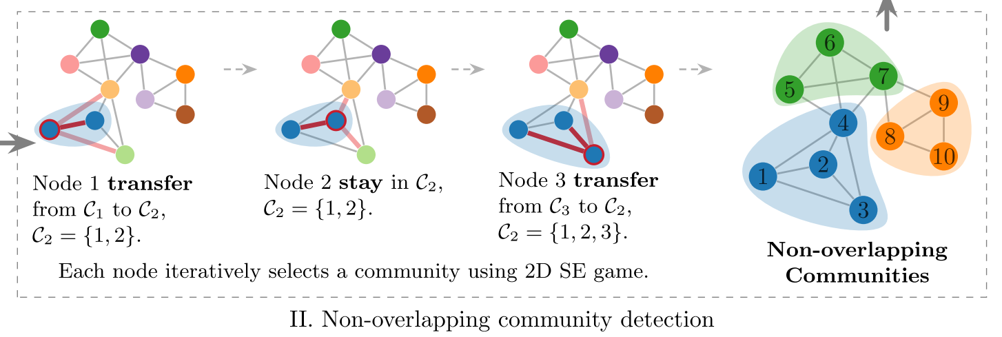
ChongqingUniversity of Technology
ATAI
AdvancedTechniqueof
Artificial Intelligence
ATAI
ChongqingUniversity _{AdvancedTechniqueof}
of Technology Artificial Intelligence
Method
(4)
(5)
(6)
(7)

Slide 6
ChongqingUniversity of Technology
ATAI
AdvancedTechniqueof
Artificial Intelligence
ATAI
ChongqingUniversity _{AdvancedTechniqueof}
of Technology Artificial Intelligence
Method

Slide 7
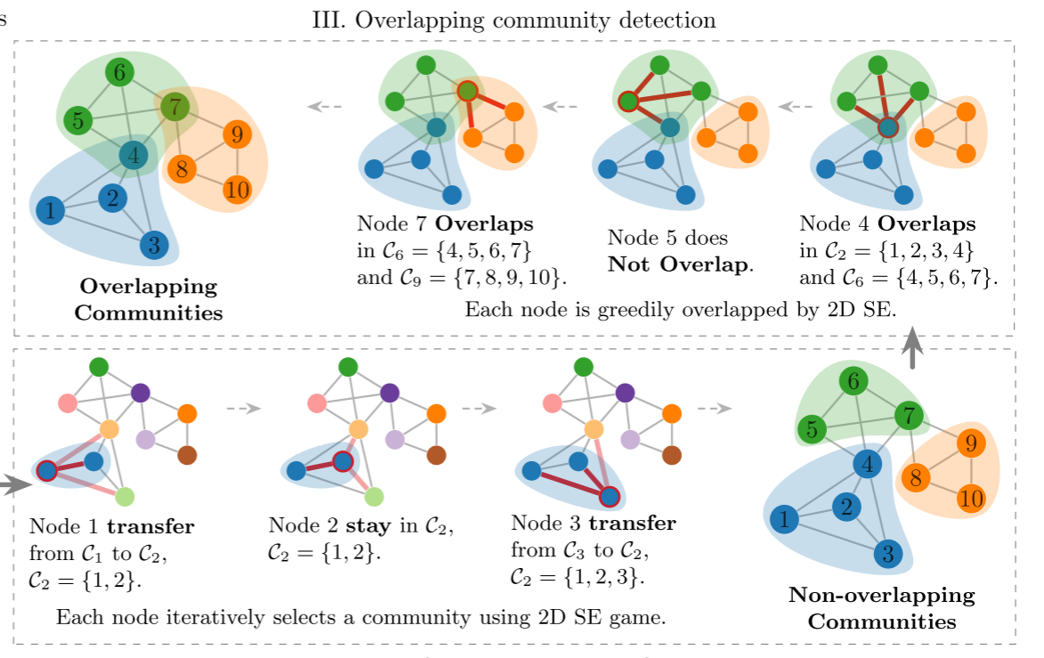
ChongqingUniversity of Technology
ATAI
AdvancedTechniqueof
Artificial Intelligence
ATAI
ChongqingUniversity _{AdvancedTechniqueof}
of Technology Artificial Intelligence
Method

Slide 8
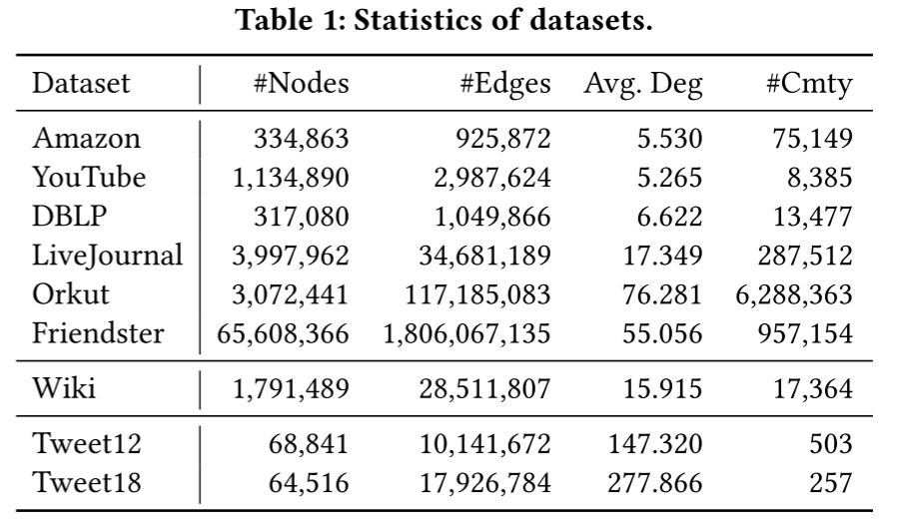
ATAI
AdvancedTechniqueof
Artificial Intelligence
ATAI
ChongqingUniversity _{AdvancedTechniqueof}
of Technology Artificial Intelligence
ChongqingUniversity of Technology
Experiments

Slide 9
ATAI
AdvancedTechniqueof
Artificial Intelligence
ATAI
ChongqingUniversity _{AdvancedTechniqueof}
of Technology Artificial Intelligence
ChongqingUniversity of Technology
Experiments

Slide 10
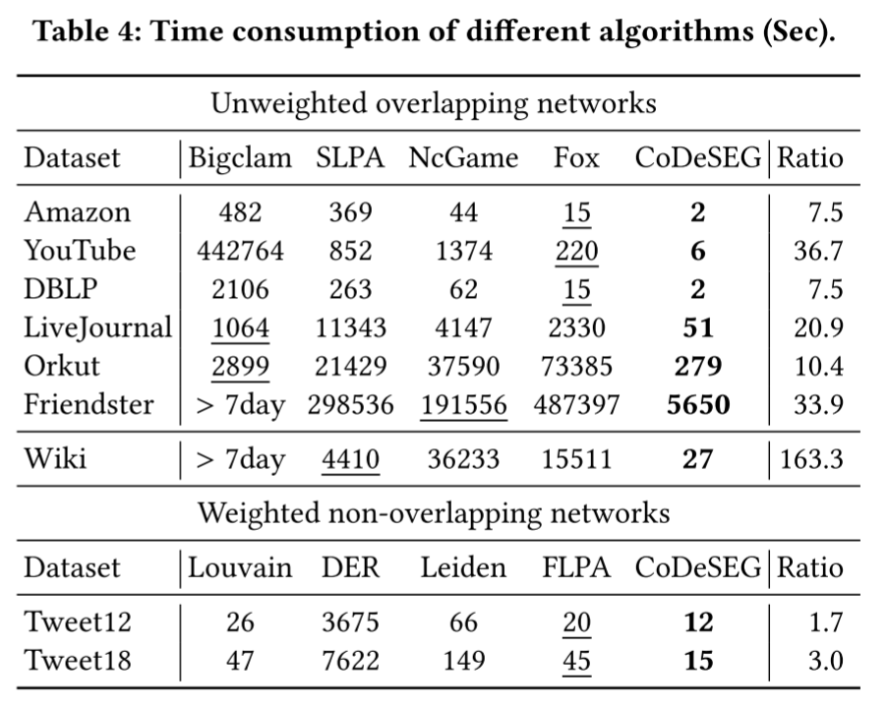
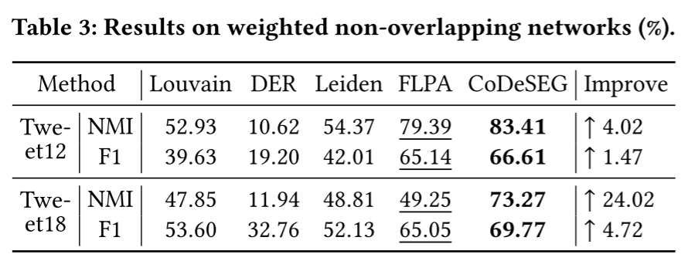
ATAI
AdvancedTechniqueof
Artificial Intelligence
ATAI
ChongqingUniversity _{AdvancedTechniqueof}
of Technology Artificial Intelligence
ChongqingUniversity of Technology
Experiments

Slide 11
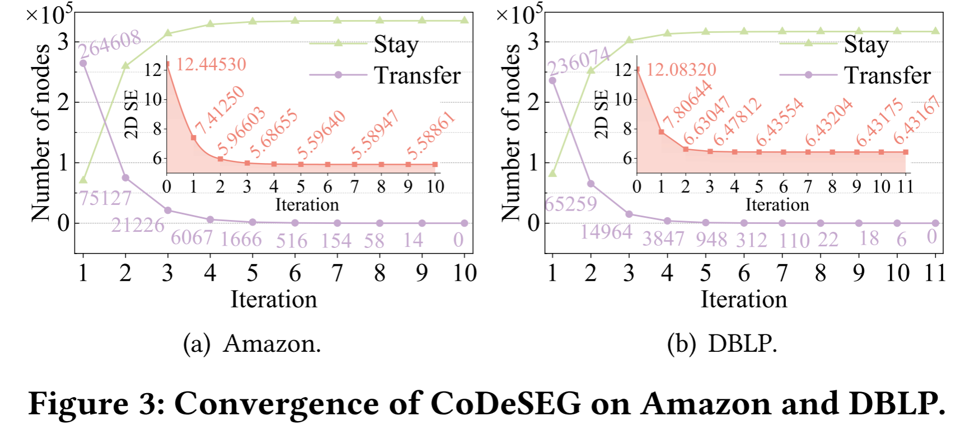
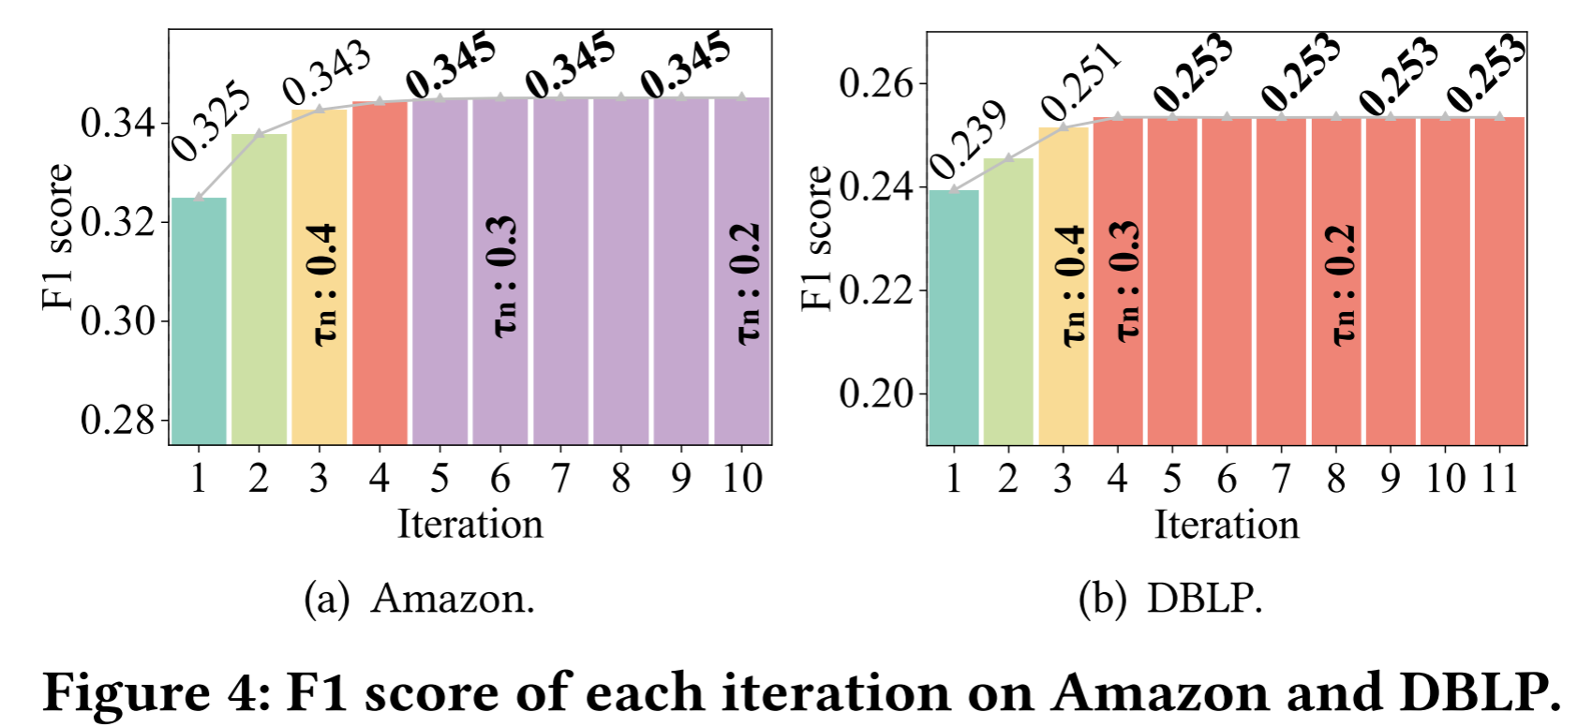
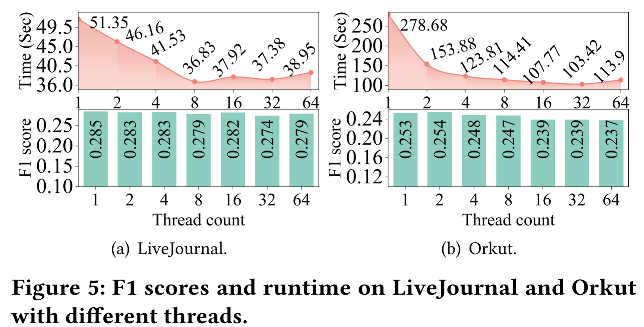
ATAI
AdvancedTechniqueof
Artificial Intelligence
ATAI
ChongqingUniversity _{AdvancedTechniqueof}
of Technology Artificial Intelligence
ChongqingUniversity of Technology
Experiments

Slide 12
ChongqingUniversity of Technology
ATAI
AdvancedTechniqueof
Artificial Intelligence
ATAI
ChongqingUniversity _{AdvancedTechniqueof}
of Technology Artificial Intelligence
Thanks!

